Slide 1
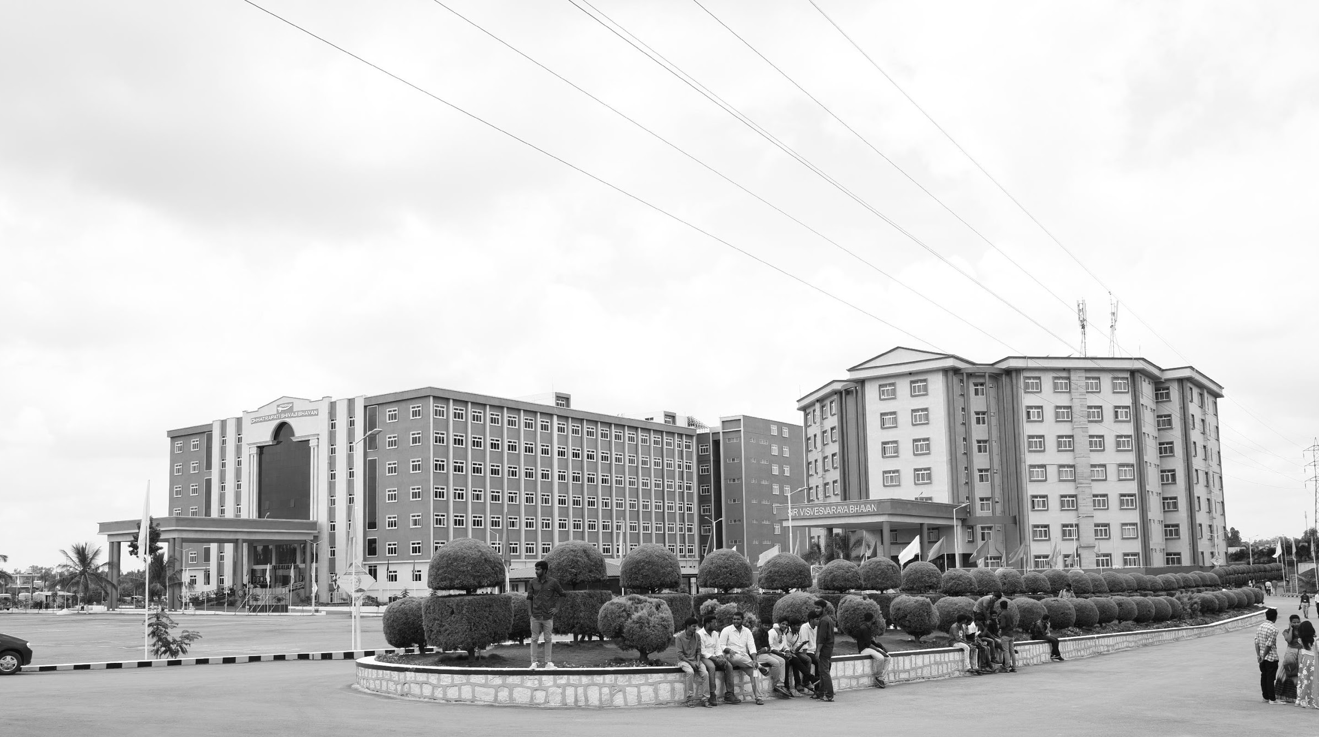

Real-Time Indian Sign Language Pose Recognition Using Deep Convolutional Neural Networks
Review-I
AY 2025-26
Capstone Project – Introduction (PROJ2999)
GITAM (Deemed-to-be) University
Department of Electrical Electronics and Communication Engineering
Project Team:
K.P. Balachandra BU22EECE0100130
C. Dinesh Karthik BU22EECE0100353
K. Vignan Uttej BU22EECE0100519
Project Mentor:
Dr. Jaya Prakash Sahoo
Project In-charge:
Kshitij Shakya
www.gitam.edu

Slide 2
Objective and Goals
Objective
The objective of this project is to develop a real-time Indian Sign Language (ISL) recognition system that captures hand gestures through a live camera feed and accurately classifies them using deep convolutional neural networks (CNNs). The system is designed to maintain high accuracy and low latency while remaining robust to variations in lighting, background, and hand orientation. Recognized gestures will be converted into text or speech output to facilitate effective communication between hearing-impaired individuals and the general population.
Goals
Main Goals:
Develop a real-time ISL recognition system using a live camera feed.
Train and deploy a deep CNN model for accurate gesture classification.
Ensure robust performance under varying lighting, background, and hand orientations.
Provide text or speech output for recognized signs to aid communication.
Maintain low latency for smooth, real-time operation on standard hardware.
Additional Goals:
Enable sentence-level translation of continuous sign sequences.
Deploy the system on web platforms to allow easy access through browsers.
Create a scalable framework for adding more gestures or supporting multiple sign languages in future.

Slide 3
10 days
10 days
10 days
10 days
7 days
9 days
7 days
8 days
6 days
4 days
2025
Project Plan
Team Formation and consent form submission
Aug 1 - Aug 8
Understanding the problem statement
Aug 11 - Aug 22
GIT and GITHUB brush-up
Aug 25 - Sep 5
Literature survey
Sep 8 - Sep 19
Report and presentation preparation
Sep 22 - Sep 25
Dataset collection analysis and augumentation
Sep 29 - Oct 7
Model training and testing
Oct 7 - Oct 17
real-time analysis of model
Oct 20 - Oct 28
development of funcional Web based UI
Oct 24 - Nov 4
Project review 2 and Project exhibition
Nov 1 - Nov 15
Aug
Sep
Oct
Nov
2025
Today

Slide 4
Literature Survey
Key Publications
Author(s) | Paper Name | Key Findings | Challenges Faced | Dataset Used
Katoch et al., 2022 | Indian Sign Language Recognition System Using SURF with SVM and CNN | SURF feature extraction with SVM and CNN achieved 96.3% accuracy on static ISL gestures. | Limited scalability; higher computation for real-time use. | Self-collected ISL image dataset
Sharma et al., 2022 | Automated Indian Sign Language Recognition System Using LSTM Models | LSTM models for dynamic ISL gestures achieved 92% accuracy on continuous video sequences. | Requires large temporal datasets; overfitting on small data. | Dynamic ISL gesture video dataset
Singh et al., 2021 | 3D-CNN Based Dynamic Gesture Recognition for Indian Sign Language | 3D-CNN model achieved 94.7% accuracy for dynamic gesture recognition. | High computational cost; large dataset required. | Dynamic ISL video dataset
Patil et al., 2021 | Indian Sign Language Recognition Using Convolutional Neural Networks | CNN-based model achieved 95% accuracy for static ISL alphabets. | Struggles with complex multi-hand or dynamic gestures. | ISL alphabet image dataset
Shenoy et al., 2021 | Real-Time Indian Sign Language Recognition Using Grid-Based Features | Grid-based real-time recognition achieved 93% accuracy on isolated ISL gestures. | Sensitive to lighting and hand orientation; limited gesture vocabulary. | Real-time ISL gesture video dataset
Goyal et al., 2023 | Indian Sign Language Recognition Using Mediapipe Holistic | Mediapipe Holistic with CNN classifier achieved 97.2% accuracy for static and simple dynamic gestures. | Requires clear hand visibility; two-handed gestures more challenging. | ISL video dataset processed with Mediapipe
Vidhyalakshmi et al., 2024 | Indian Sign Language Recognition Using Transfer Learning with EfficientNetB0 | Transfer learning with EfficientNetB0 reached 98.1% accuracy with limited training data. | Pretrained model may not fully generalize to unseen gestures. | ISL image/video dataset

Slide 5
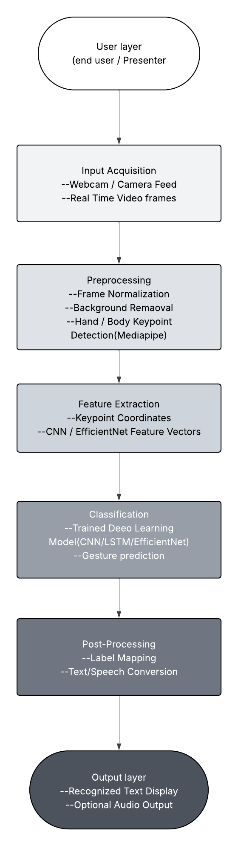
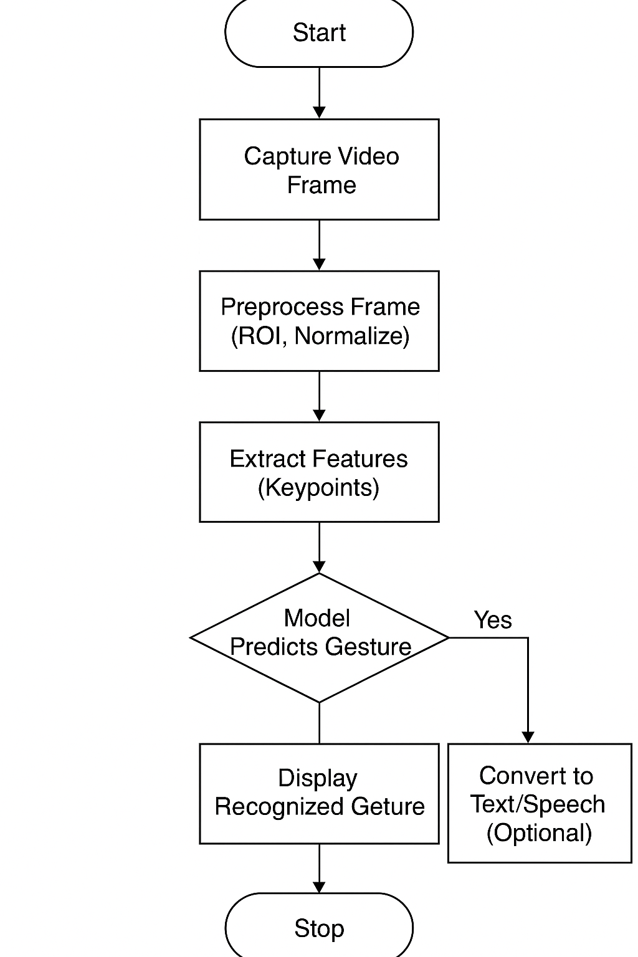
Architecture
Structural Diagram
Behaviour Diagram

Slide 6
Use Cases & Testing
Use Cases
Real-Time Gesture Recognition: User performs an ISL gesture in front of the webcam; the system captures the video feed, processes it, and displays the recognized sign as text (and optional speech).
Continuous Gesture Recognition: System processes a sequence of gestures in real time and updates the output text for each recognized sign with minimal delay.
Web Platform Deployment: The trained CNN model is deployed on a server so users can access the recognition system directly through a web browser without installations.
Audio Feedback: After a gesture is recognized, the system converts the predicted text into speech to assist communication with non-signers.
Test Cases
Single Static Gesture – Perform a known ISL gesture (e.g., “Hello”); the correct label should appear on screen ≥95% of attempts.
Dynamic Gesture – Perform a moving gesture (e.g., “Thank You”); prediction updates in real time with <1 second delay.
Low-Lighting Condition – Test recognition accuracy when lighting is dim; accuracy should remain ≥85%.
Background Variation – Perform gestures with cluttered backgrounds; accuracy should remain ≥90%.
Continuous Sequence – Perform three gestures in succession; all gestures should be recognized in the correct order.
Text-to-Speech Output – Enable speech option; recognized gesture is spoken aloud within 1 second.

Slide 7
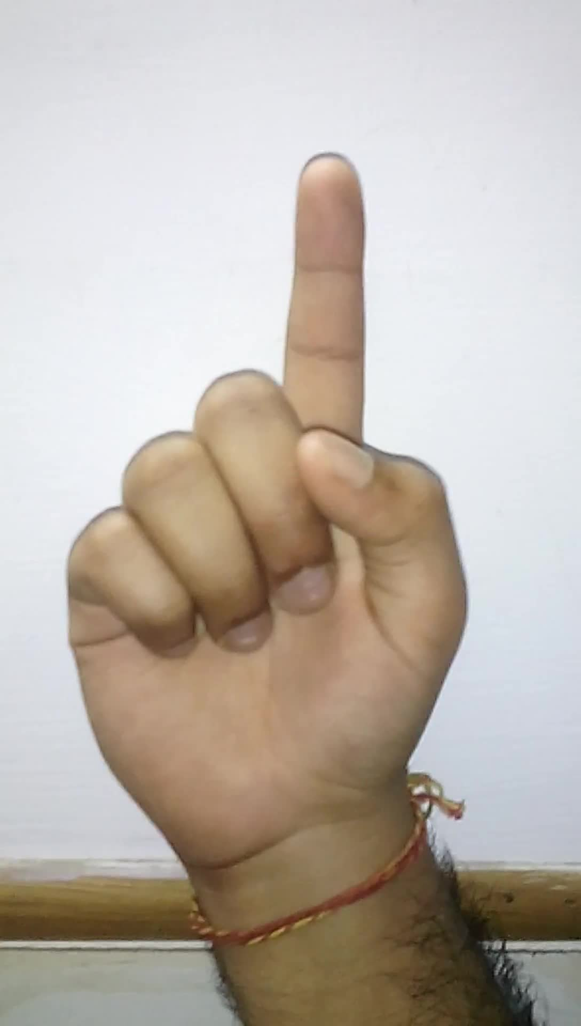
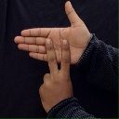

Implementation and Results – Iteration 1
Dataset Description:
Dataset: Indian Sign Language (ISL) Dataset.
Size: 42,000 images.
Source: Kaggle.
Classes: 35 (26 English alphabets A–Z and numerals 1–9).
Training and Testing Split: 70% for training, 30% for testing.
Letter ‘I’
Letter ‘N’
Number ‘6’

Slide 8
Conclusion & Future Work
Summary:
This project successfully demonstrates a real-time Indian Sign Language (ISL) recognition system that captures hand gestures through a web-based platform and accurately classifies them using deep convolutional neural networks (CNNs).
The system achieves high accuracy with low latency, remains robust to lighting and background variations, and provides text or speech output to enable seamless communication between hearing-impaired individuals and the general population.
This work highlights the potential of deep learning in assistive technology and lays the foundation for future enhancements such as sentence-level translation, expanded gesture datasets, and scalable web deployment for widespread accessibility.
Future Work:
Model Training & Optimization Train the collected dataset using deep CNN architectures and fine-tune hyperparameters for high accuracy and low latency.
Real-Time Integration Develop the web application to process live camera input and deliver instant gesture predictions.
Text & Speech Output Implement a module to convert recognized gestures into text and optional speech for clear communication.
Robustness & Scalability Improve performance under varying lighting, background, and hand orientations, and expand the dataset to cover more ISL signs.
Deployment & Testing Deploy the trained model on a web platform and conduct usability testing across different devices and browsers.

Slide 9
THANK YOU
Have a Great Day !

